Slide 1
Transport of Mass
Constitutve
and
balance equations

Slide 3
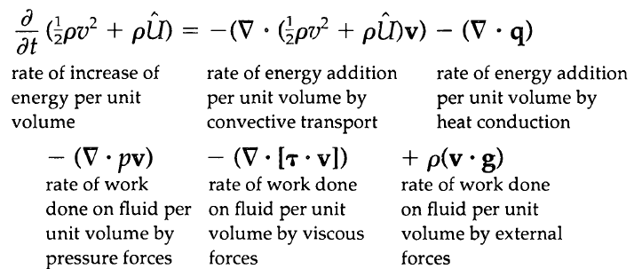
. (any flux ) = (flow rate out)-(flow rate in), per unit volume

Slide 4
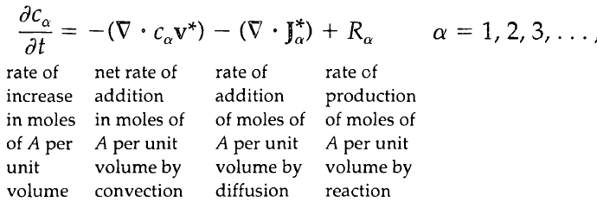
. (any flux ) = (flow rate out)-(flow rate in) per unit volume
C=cost.

Slide 5
C=cost.
ρ=cost
C=cost

Slide 6
ρ, D_{ab}=cost
Eq. 19.1-16
Left side is density + substantial derivative of ω
c , D_{ab}=cost
Eq19.1-15
C=cost.
ρ=cost
C=cost

Slide 7
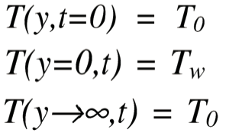
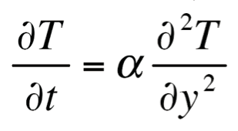
ρ, D_{ab}=cost
Eq. 19.1-16
Left side is: ρ * ( substantial derivative of ω)
c , D_{ab}=cost
Eq19.1-15
C=cost.
ρ, k = cost
Quale forma e’ piu’ comoda e quando?
, D = Costants
V = 0

Slide 8
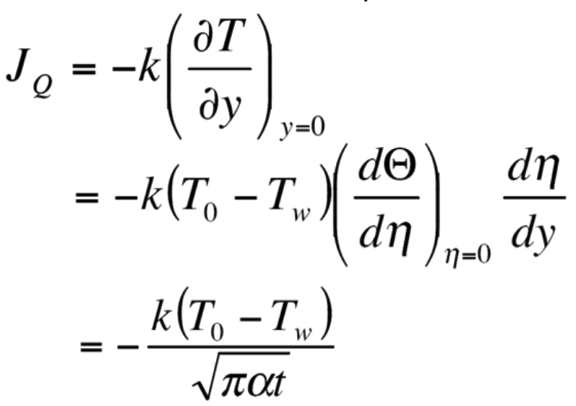
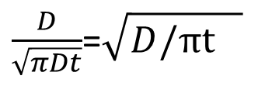
, D = Costants
V = 0
T_{o} ,
C_{o}
T_{w} ,
C_{w}
h =$\frac{K}{\sqrt{παt}}$=$\sqrt{{\frac{k}{πtα}}^{2}}$= $\sqrt{{κ^{2}ρc_{p}/πtκ}^{}}$
K_{c} =
$\frac{D}{\sqrt{πDt}}$=$\sqrt{{D/πt}^{}}$

